Slide 1
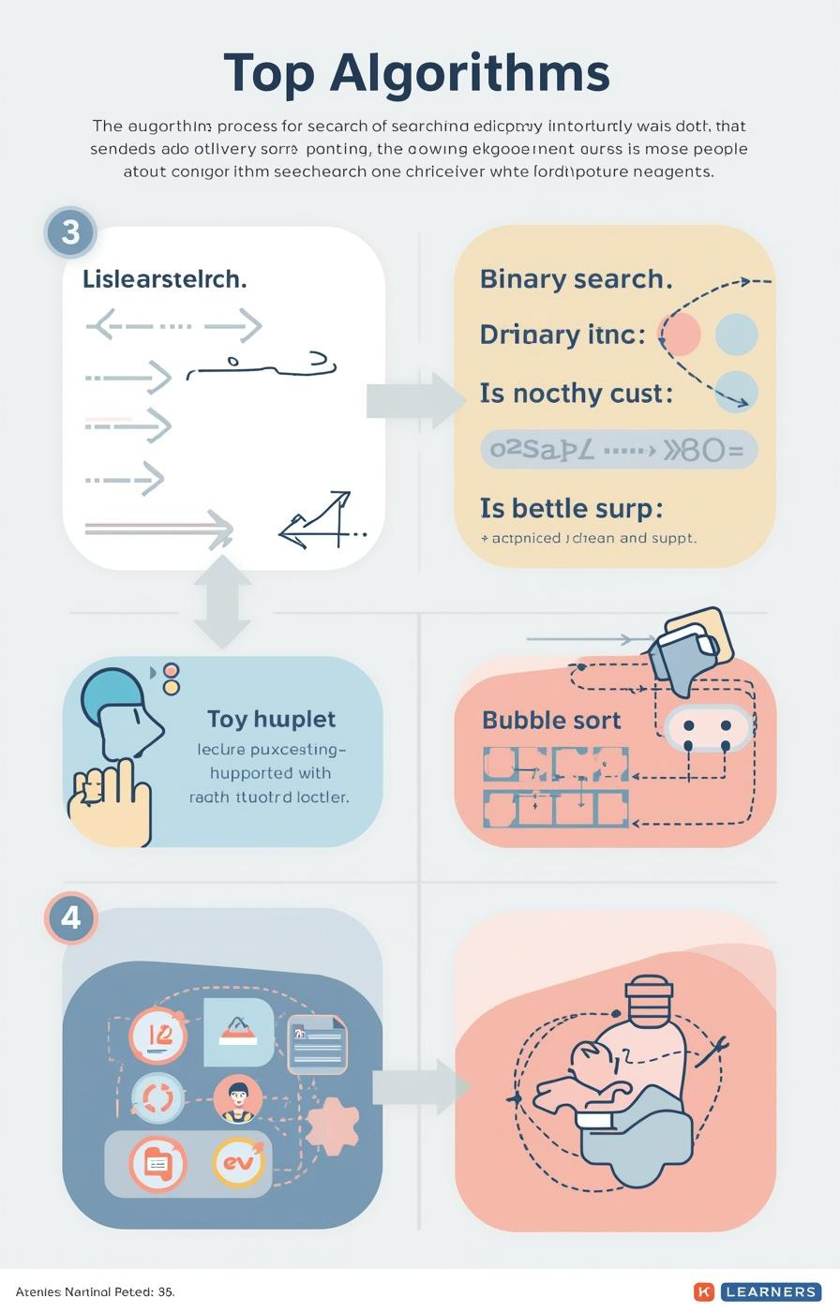

Algorithms: Searching and Sorting
by Mr. Edward Paul

Slide 2

Understanding Algorithms
Their Importance in Computer Science
Algorithms are essential, defined as step-by-step procedures for solving problems. They enable computers to efficiently process information, making them a fundamental aspect of computer science and programming.
2

Slide 3

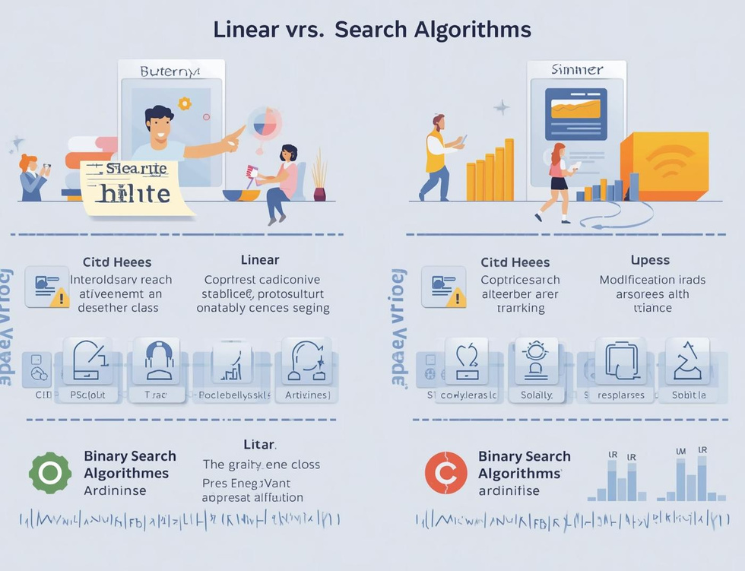
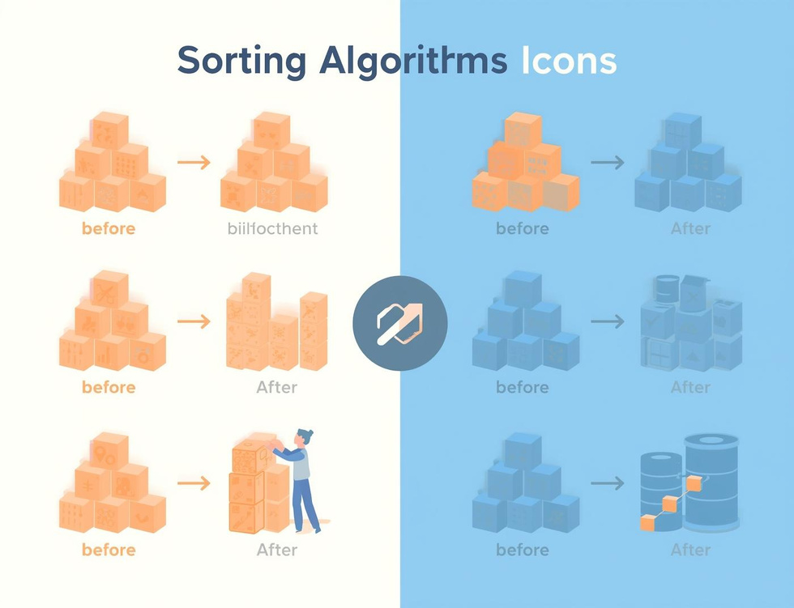
Learning Objectives
Search Algorithms
Compare Efficiencies
Bubble Sort
Understand how algorithms locate data effectively through different searching techniques.
Learn the efficiency differences between linear and binary search methods in data retrieval.
Understand the basics of bubble sort and how it organizes data through comparisons.

Slide 4
Linear Search
Sequential Scanning for Data Retrieval
Definition
Simple Mechanism
Use Cases
Linear search is a straightforward algorithm that checks each element in a list sequentially until it finds the target value or reaches the end of the list.
This method is easy to implement but can be inefficient for large datasets, as it might require examining every single item before locating the desired information.
Linear search is particularly useful for small or unsorted datasets where quick implementation is necessary, making it an ideal choice for simple search tasks.
4

Slide 5
Binary Search
Divide and Conquer Method Explained
Definition
Mechanism
Requirements
Binary search is a fast search algorithm that finds the position of a target value within a sorted array, using a divide-and-conquer strategy for efficiency.
The algorithm repeatedly divides the search interval in half; comparing the target value to the middle element, it narrows down the potential location until the target is found.
For binary search to work, the data must be sorted beforehand; this prerequisite allows the algorithm to efficiently eliminate half of the remaining elements with each comparison.
5

Slide 6
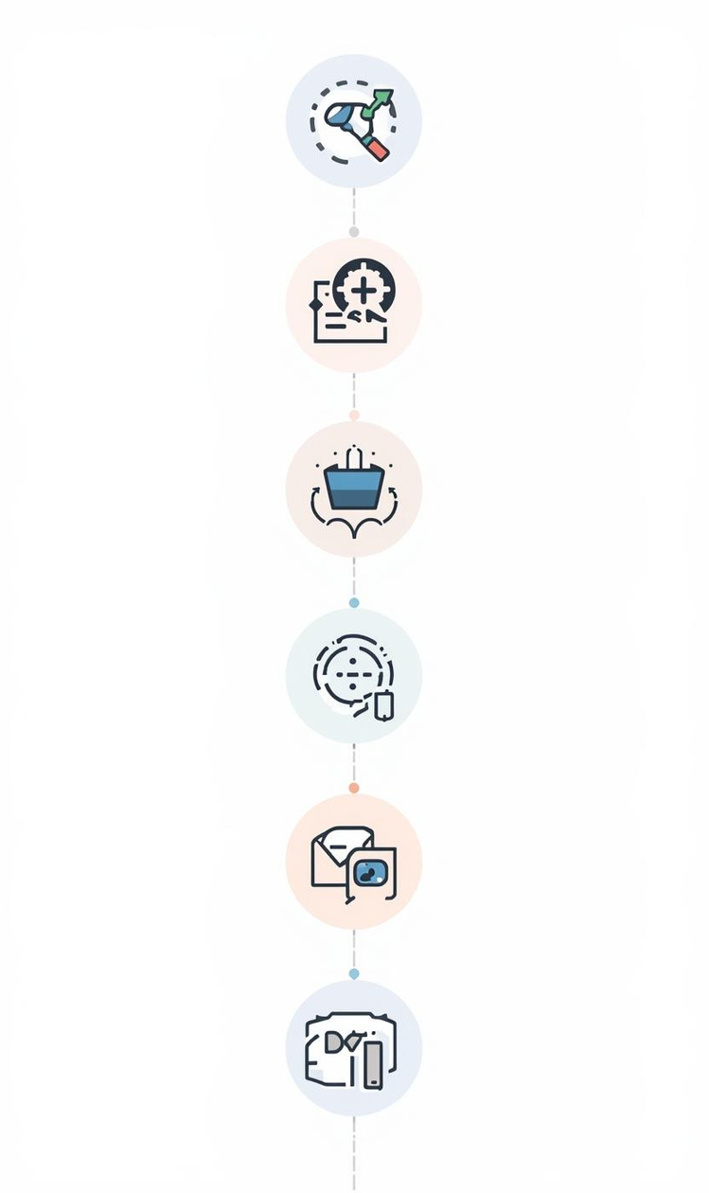
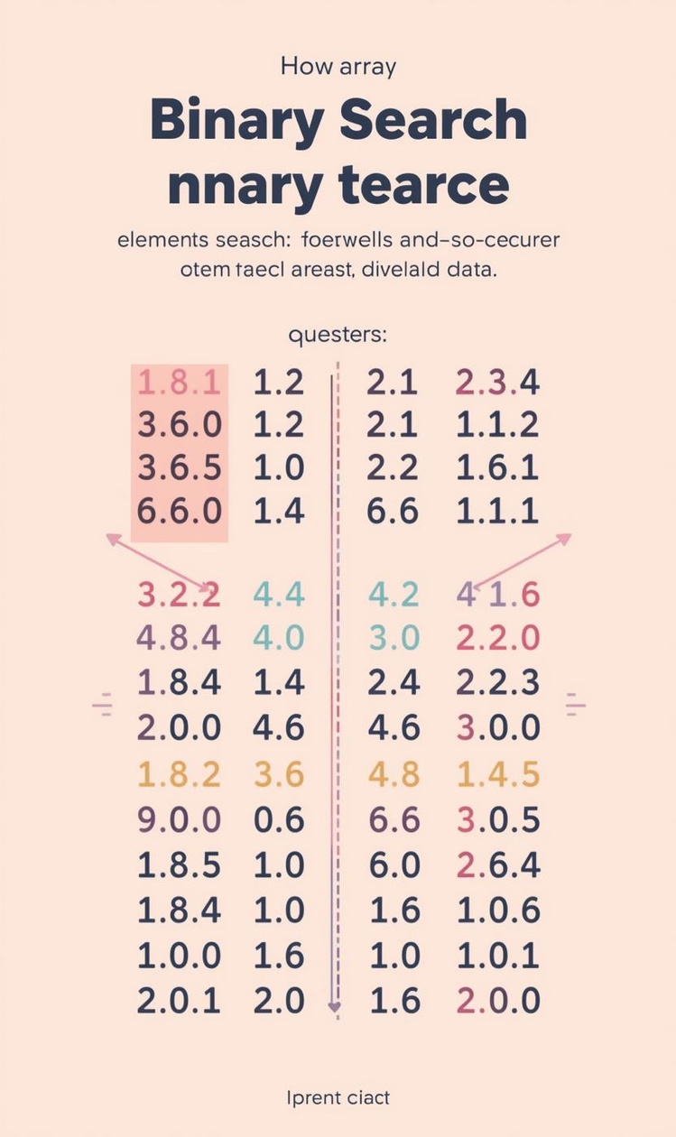

Comparing Efficiency of Search Algorithms
Efficiency
Pros and Cons
Linear search has O(n) time complexity.
Binary search is faster but needs sorted data.

Slide 7
Algorithm Tracing
Linear Search
Binary Search
Efficiency Comparison
In linear search, each element is examined sequentially until the target is found. This straightforward approach is effective for small or unsorted datasets, but can be slow for larger lists.
Binary search requires a sorted list, dividing the search space in half repeatedly, which drastically reduces the number of checks needed to find the target value, making it more efficient than linear search.
Comparing the two searches, linear search has a time complexity of O(n), while binary search operates at O(log n), highlighting the significant efficiency gained through the divide-and-conquer strategy of binary search.

Slide 8
Bubble Sort
Introducing Sorting Algorithms and Their Importance
8

Slide 9
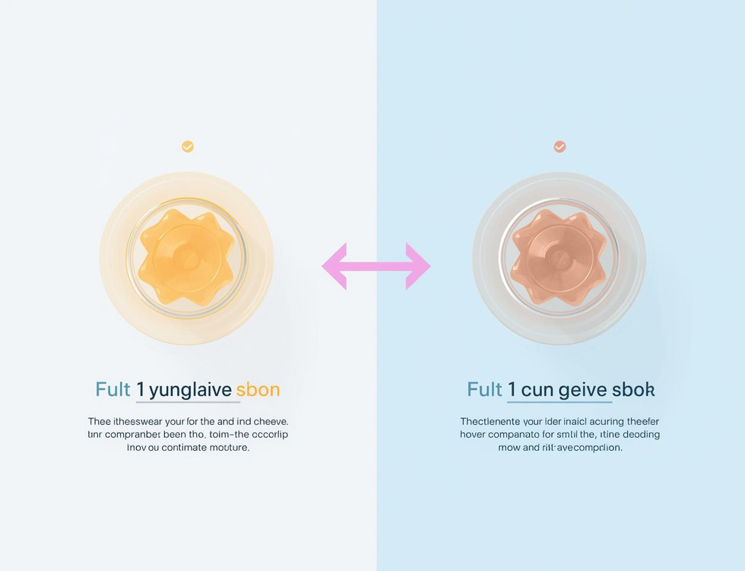
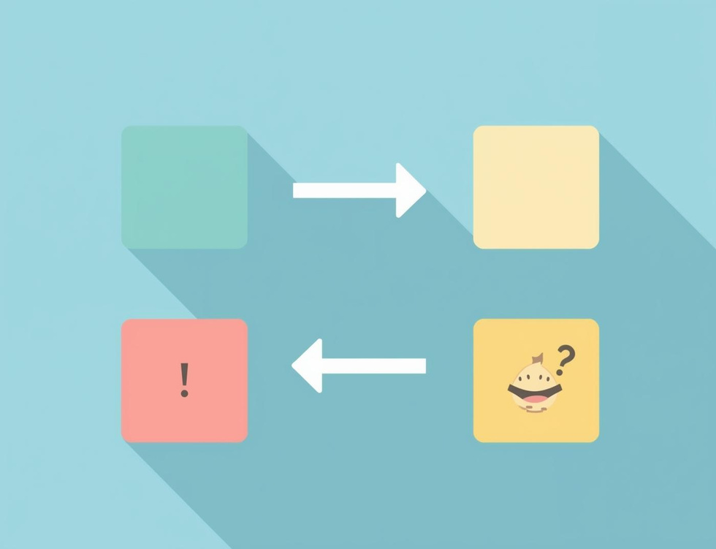
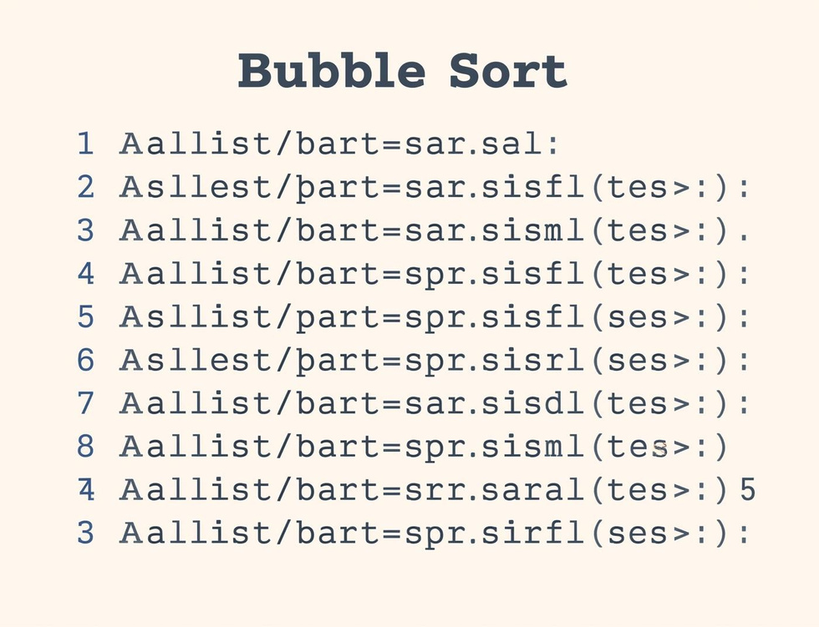
Bubble Sort Steps
Compare Elements
Swap if Needed
Repeat Passes
Compare adjacent elements to determine if they need swapping for sorting.
Elements are swapped if they are in the wrong order, ensuring sorting progress.
The sorting process continues with repeated passes until the entire list is sorted.

Slide 10
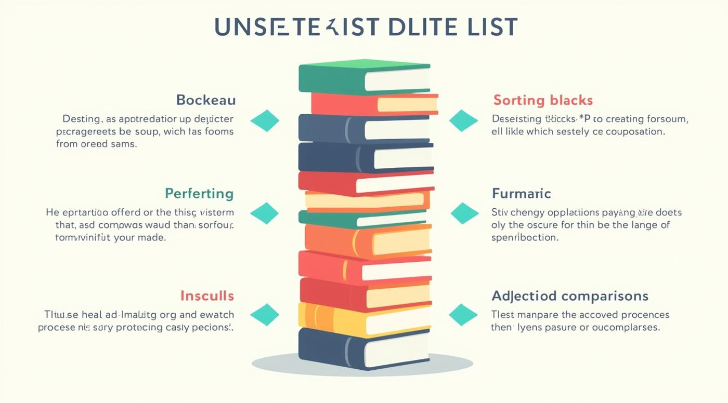
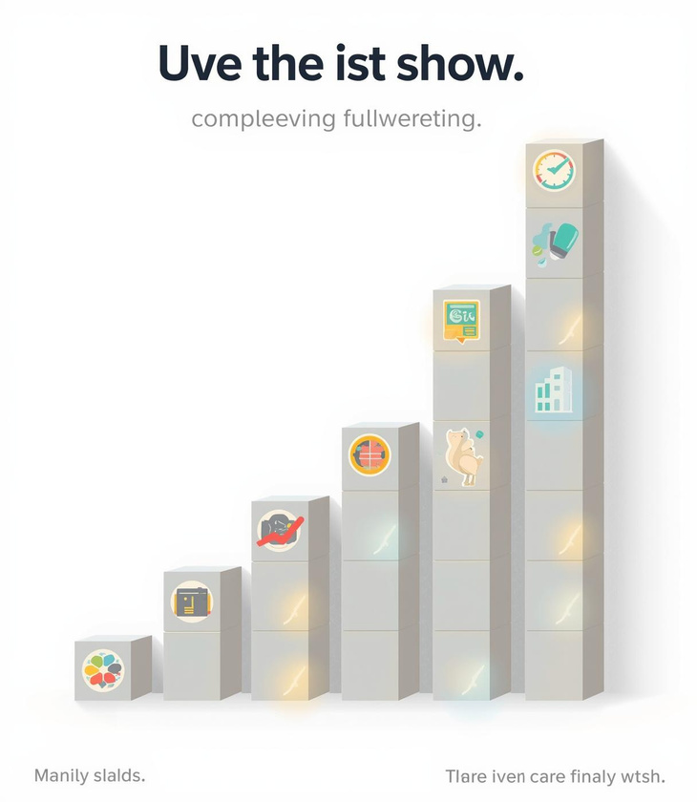
Tracing Bubble Sort Steps

Slide 11
Key Takeaways and Insights
01
Search Algorithms
Linear and binary searches each have distinct strengths.
02
Sorting Concepts
Bubble sort is an essential foundational sorting algorithm.
03
Tracing Importance
Understanding algorithms requires step-by-step tracing practice.

Slide 12

Continue Learning
Practice tracing algorithms today!

Slide 13
Lesson on Graphics & DTP fundamentals Practicals - Year 7
AI-Generated Teaching Slides

Slide 14
Okay, here is a detailed lesson pack for Year 7 on "Graphics & DTP Fundamentals
---
## Lesson Pack: Graphics & DTP Fundamentals Practicals - Year 7
**Topic:** Introduction to Graphics & Desktop Publishing (DTP) for Practical Application
**Target Audience:** Year 7 Computing / ICT
**Time Allotment:** 60-75 minutes (adaptable)
---
### 1. Lesson Objectives
By the end of this lesson, students will be able to:
* **Define** Desktop Publishing (DTP) and explain its purpose in creating visual documents.
* **Identify** common graphic types (e.g., photographs, illustrations/clip art) and understand their role in DTP.
* **Use** a DTP/graphics software (e.g., Google Drawings, Canva, Publisher) to create a simple document like a poster or flyer.
* **Apply** basic design principles such as text boxes, image placement, and font choice for readability and visual appeal.
* **Reflect** on the effectiveness of their design and suggest improvements.
---
### 2. Introduction / Starter Activity (10-15 minutes)
**Activity: "Spot the Design Disaster!"**

Slide 15
**Display:** Show students two versions of a simple poster or flyer side-by-side
* **Version A (Disaster):** Cluttered, too many clashing fonts, poor colour contrast, stretched/pixelated images, information is hard to read.
* **Version B (Effective):** Clear layout, consistent fonts, good colour contrast, appropriate images, easy to read.
* *Example Content:* A poster for a "School Bake Sale" or "Lost Pet."

Slide 16
**Discussion (Think-Pair-Share):**
* "Look at these two posters. What do you notice about them?"
* "Which one is easier to understand? Why?"
* "What makes Poster A difficult to read or look at?"
* "What makes Poster B effective?"
* Introduce terms like 'layout,' 'readability,' 'visual appeal,' and 'information hierarchy' organically from their observations.

Slide 17
**Introduce DTP:** Explain that the process of creating documents like these, co
---
### 3. Key Teaching Points (15-20 minutes)
*(Delivered via discussion, demonstration, and visual aids - i.e., the PowerPoint)*

Slide 18
**What is Desktop Publishing (DTP)?**
* **Definition:** Using a computer and software to create documents that combine text and graphics for print or digital display.
* **Purpose:** To make professional-looking documents for various uses.
* **Examples:** Posters, flyers, brochures, newspapers, magazines, books, advertisements, invitations. (Show visual examples for each).
* **Key Concept:** It's more than just typing in a word processor; it's about *designing* the page.

Slide 19
**Graphics Fundamentals:**
* **What are Graphics?** Visual elements like images, photos, illustrations, drawings, logos, icons.
* **Why use them?** To grab attention, illustrate points, convey emotions, break up text, enhance visual appeal.
* **Types (Simplified for Y7):**
* **Photographs:** Realistic images taken with a camera (e.g., JPG files). Good for showing real things.
* **Illustrations/Clip Art:** Drawings, cartoons, diagrams (e.g., PNG for transparency, simple vector shapes). Good for conceptual ideas or adding fun.
* **Important Considerations:**
* **Relevance:** Does the image fit the message?
* **Quality:** Is it clear, not blurry or pixelated? (Demonstrate a good vs. bad image).
* **Copyright/Source:** Where do we get images? (Mention royalty-free sources like Pixabay, Unsplash, or school-provided image banks). *Briefly touch on not just 'taking' images from Google without checking.*

Slide 20
**Basic DTP Software Tools:**
* **Page/Canvas:** The blank space where you create your document.
* **Text Box:** A movable, resizable box specifically for typing text. (Crucial difference from just typing on the page).
* **Image Frame/Placeholder:** Where images are inserted and manipulated.
* **Shape Tools:** For adding rectangles, circles, lines, etc., to highlight information or add design elements.
* **Colour Palette:** Choosing colours for text, shapes, and backgrounds.

Slide 21
**Basic Design Principles (for Year 7):**
* **Layout:** How text and images are arranged on the page. Aim for a clear, uncluttered look.
* **Readability:** Can people easily read your text?
* **Font Choice:** Use 1-2 clear, easy-to-read fonts. Avoid too many fancy ones.
* **Font Size:** Headlines big, body text readable from a distance.
* **Colour Contrast:** Dark text on light background (or vice-versa). Avoid colours that blend.
* **Visual Hierarchy:** What's the most important information? Make it stand out (bigger font, bold, central image).
* **White Space:** Don't fill every single bit of the page! Empty space helps guide the eye and reduces clutter.
---
### 4. Guided Practice or Activities (25-30 minutes)
**Activity: "Design a School Event Poster"**
Students will create a simple poster for a hypothetical school event.

Slide 22
**Scenario:** Students choose ONE of the following scenarios to create a poster
* **Scenario A:** "School's Annual Sports Day" (Date, time, location, activities, 'come support us!')
* **Scenario B:** "Talent Show Auditions" (Date, time, place, what to prepare, 'sign up now!')
* **Scenario C:** "Lost School Mascot" (Description, where last seen, contact info, reward - allows for a clear image).

Slide 23
**Software:** Use accessible software:
* **Recommended:** Google Drawings (free, web-based, collaborative), Canva (free education accounts available), Microsoft Publisher, LibreOffice Draw.
* **Alternative (Simpler):** Microsoft Paint (for basic image editing then pasting into a word processor for text), Google Docs (using text boxes and image wrapping).
* *Teacher Note:* Ensure students have access to the chosen software and ideally a pre-prepared folder of safe, royalty-free images they can use for their chosen scenario.

Slide 24
**Step-by-Step Guidance (Teacher Demonstrates, Students Follow):**
* **Step 1: Get Started:** Open the chosen software. Create a new document/canvas.
* **Step 2: Title & Headline:**
* Add a large, clear **text box** for the main title (e.g., "SCHOOL SPORTS DAY!").
* Choose a clear, bold font and an appropriate size.
* Position it at the top.
* **Step 3: Event Details:**
* Add separate **text boxes** for key information (Date, Time, Location, What to bring/do).
* Choose a slightly smaller but still readable font.
* Arrange these logically.
* **Step 4: Add a Graphic:**
* Demonstrate how to **insert an image** (from the provided folder).
* Show how to **resize** and **move** the image without stretching it disproportionately.
* Place it prominently but without covering essential text.
* **Step 5: Enhance & Refine:**
* Add a simple **shape** (e.g., a rectangle behind the title for emphasis, a border).
* Experiment with **colour** for text or shapes (emphasize good contrast).
* Review their poster against the "Good Design Principles" discussed earlier. *Is it clear? Is it easy to read? Does it look appealing?*
* **Step 6: Save & Export:** Instruct students to save their work (e.g., as a JPG or PNG image, or the native software file).

Slide 25
**Differentiation:**
* **Support:** Provide pre-made templates with text boxes and image placeholders ready. Offer specific fonts/colours to choose from. Work in pairs.
* **Challenge:** Ask students to create a small school logo or add a call to action (e.g., a QR code placeholder). Explore advanced text formatting or alignment options.
---
### 5. Assessment Ideas (5-10 minutes)
**Formative Assessment during the lesson:**
* **Teacher Observation:** Circulate the room, provide immediate feedback, check for understanding of tools and principles.
* **Quick Check-in:** Ask students to show their screen at a certain point. "Can you show me your title?" "How did you add that image?"
**Summative / End of lesson Assessment:**
* **Poster Submission:** Students submit their completed poster.
* **Rubric/Checklist:** Assess against the objectives:
* **Clarity of Information:** Is all essential information present and easy to find? (20%)
* **Effective Use of Graphics:** Is the graphic relevant, clear, and well-placed? (25%)
* **Layout & Readability:** Is the text readable, well-sized, and are elements arranged logically? (30%)
* **Visual Appeal:** Is the overall design attractive and engaging (good use of colour, white space)? (15%)
* **Software Proficiency:** Did they effectively use the software's basic tools? (10%)
* **Peer Feedback (Optional, if time):** Students display their posters and use a simple "Two Stars and a Wish" feedback form for a partner's work.
* *Star 1:* "I really liked how you..."
* *Star 2:* "Your poster was great because..."
* *Wish:* "Next time, you could try to improve..."
---
### 6. Summary / Conclusion (5 minutes)

Slide 26
**Review Objectives:** Briefly revisit the lesson objectives. "Can you now defin

Slide 27
**Quick Q&A:**
* "What was one new thing you learned today about making a poster?"
* "Why is good design important?"
* "Where else might you see DTP in action?"

Slide 28
**Real-World Connection:** Reiterate that DTP skills are valuable for school pro

Slide 29
**Homework/Extension (Optional):** Ask students to find examples of good and bad
---
### 7. PowerPoint Slide Outline
**(Approx. 19 slides)**
**Slide 1: Title Slide**
* Title: Graphics & DTP Fundamentals Practicals
* Subtitle: Creating Engaging Visual Documents
* Your Name / School Logo
* Year 7 Computing
**Slide 2: Lesson Objectives**
* By the end of this lesson, you will be able to:
* Define Desktop Publishing (DTP) & its purpose.
* Identify common graphic types.
* Use DTP software to create a simple document.
* Apply basic design principles (layout, text, images).
* Reflect on your design.
**Slide 3: Starter Activity: Spot the Design Disaster!**
* [Image: Poorly designed poster - e.g., cluttered, bad fonts, pixelated image]
* [Image: Well-designed poster - e.g., clean, readable, clear image]
* Which one is better? Why?
* Think-Pair-Share Discussion.
**Slide 4: What is Desktop Publishing (DTP)?**
* Definition: Using a computer and software to create documents that combine text and graphics.
* Purpose: To make professional-looking documents for print or digital.
* It's about *designing* the page, not just typing!
**Slide 5: Where do we see DTP? (Examples)**
* [Image: Newspaper front page] Newspapers & Magazines
* [Image: Event flyer] Posters & Flyers
* [Image: Brochure] Brochures & Leaflets
* [Image: Book cover] Books & Reports
* [Image: Invitation card] Invitations & Cards
**Slide 6: Graphics Fundamentals: What are they?**
* Graphics are visual elements.
* Why use them?
* Grab attention
* Illustrate points
* Convey emotions
* Make things look good!
* [Image: Collection of various graphics - photo, icon, illustration]
**Slide 7: Types of Graphics (for DTP)**
* **Photographs:** Realistic images from cameras.
* [Image: High-quality photo]
* Good for showing real objects or people.
* **Illustrations / Clip Art:** Drawings, cartoons, diagrams.
* [Image: Simple cartoon illustration]
* Good for concepts, fun, or simple visuals.
* **Always check:** Relevance, Quality, Source (Copyright!)
**Slide 8: Key DTP Software Tools**
* **Page/Canvas:** Your digital workspace.
* **Text Box:** Special box for text – you can move and resize it!
* [Image: Screenshot of text box being used in software]
* **Image Frame:** Area where you place pictures.
* [Image: Screenshot of image frame/placeholder]
* **Shape Tools:** Rectangles, circles, lines to add design.
**Slide 9: Basic Design Principles (How to make it look good!)**
* **1. Layout:** How things are arranged on the page. Keep it tidy!
* [Image: Good vs. Bad layout example]
* **2. Readability:** Can people easily read your text?
* **Font Choice:** Use 1-2 clear fonts.
* **Font Size:** Big for headlines, smaller for details.
* **Colour Contrast:** Dark text on light background (or vice-versa).
* [Image: Good vs. Bad font/contrast example]
**Slide 10: Basic Design Principles (Continued)**
* **3. Visual Hierarchy:** What's most important? Make it stand out!
* [Image: Example showing a clear headline vs. smaller body text]
* **4. White Space:** Don't cram everything in! Empty space helps guide the eye.
* [Image: Example showing a cluttered vs. clear use of white space]
**Slide 11: Activity: Design a School Event Poster!**
* **Your Task:** Create a poster for a school event.
* **Choose ONE scenario:**
* School Sports Day
* Talent Show Auditions
* Lost School Mascot
* **Software:** [Name of chosen software, e.g., Google Drawings / Canva]
**Slide 12: Step 1: Planning Your Poster**
* What is your chosen event?
* What is the **MOST IMPORTANT** information? (Who, What, When, Where, Why)
* What kind of image would be relevant?
* What colours might fit the event? (e.g., bright for Sports Day, mysterious for Lost Mascot)
**Slide 13: Step 2: Getting Started (Software Intro)**
* Open [Software Name].
* Create a new document/canvas.
* **Demonstration:** [Teacher demonstrates basic setup briefly]
**Slide 14: Step 3: Add Your Text & Images**
* **Title:** Use a big, bold **text box** for your main headline.
* **Details:** Add more **text boxes** for event information.
* **Image:** **Insert an image** from our shared folder. Resize it carefully!
* [Image: Screenshot of inserting text/image in software]
**Slide 15: Step 4: Arrange & Refine Your Design**
* **Move** text boxes and images around for the best layout.
* Add a simple **shape** or **line** if you wish.
* Experiment with **colours** (remember contrast!).
* Ask yourself: Is it clear? Is it readable? Is it appealing?
* [Image: Screenshot of arranging elements]
**Slide 16: Saving & Sharing Your Work**
* **Save** your project regularly!
* File > Save (or similar)
* **Export/Download** as an image (e.g., JPG or PNG) for submission.
**Slide 17: Peer / Self-Assessment (If time permits)**
* Look at your own poster (or a partner's).
* **Two Stars:** Name two things that are really good about the design.
* **One Wish:** Name one thing that could be improved.
* [Simple feedback form template]
**Slide 18: Review & Q&A**
* What is DTP?
* Why use graphics in DTP?
* What are 2 things that make a poster easy to read?
* What was your favourite tool to use today?
**Slide 19: Challenge & Next Steps**
* How could you make your poster even better next time?
* Where else could you use DTP skills?
* Thanks for designing!
---

